Slide 1
Xerox® IridesseTM Production Press
Be Brilliant
Notes:
Welcome
NOTE TO PRESENTER: A number of the slides in this presentation incorporate video clips that showcase Iridesse applications.
Please run the slides in presentation mode to activate the videos.

Slide 2
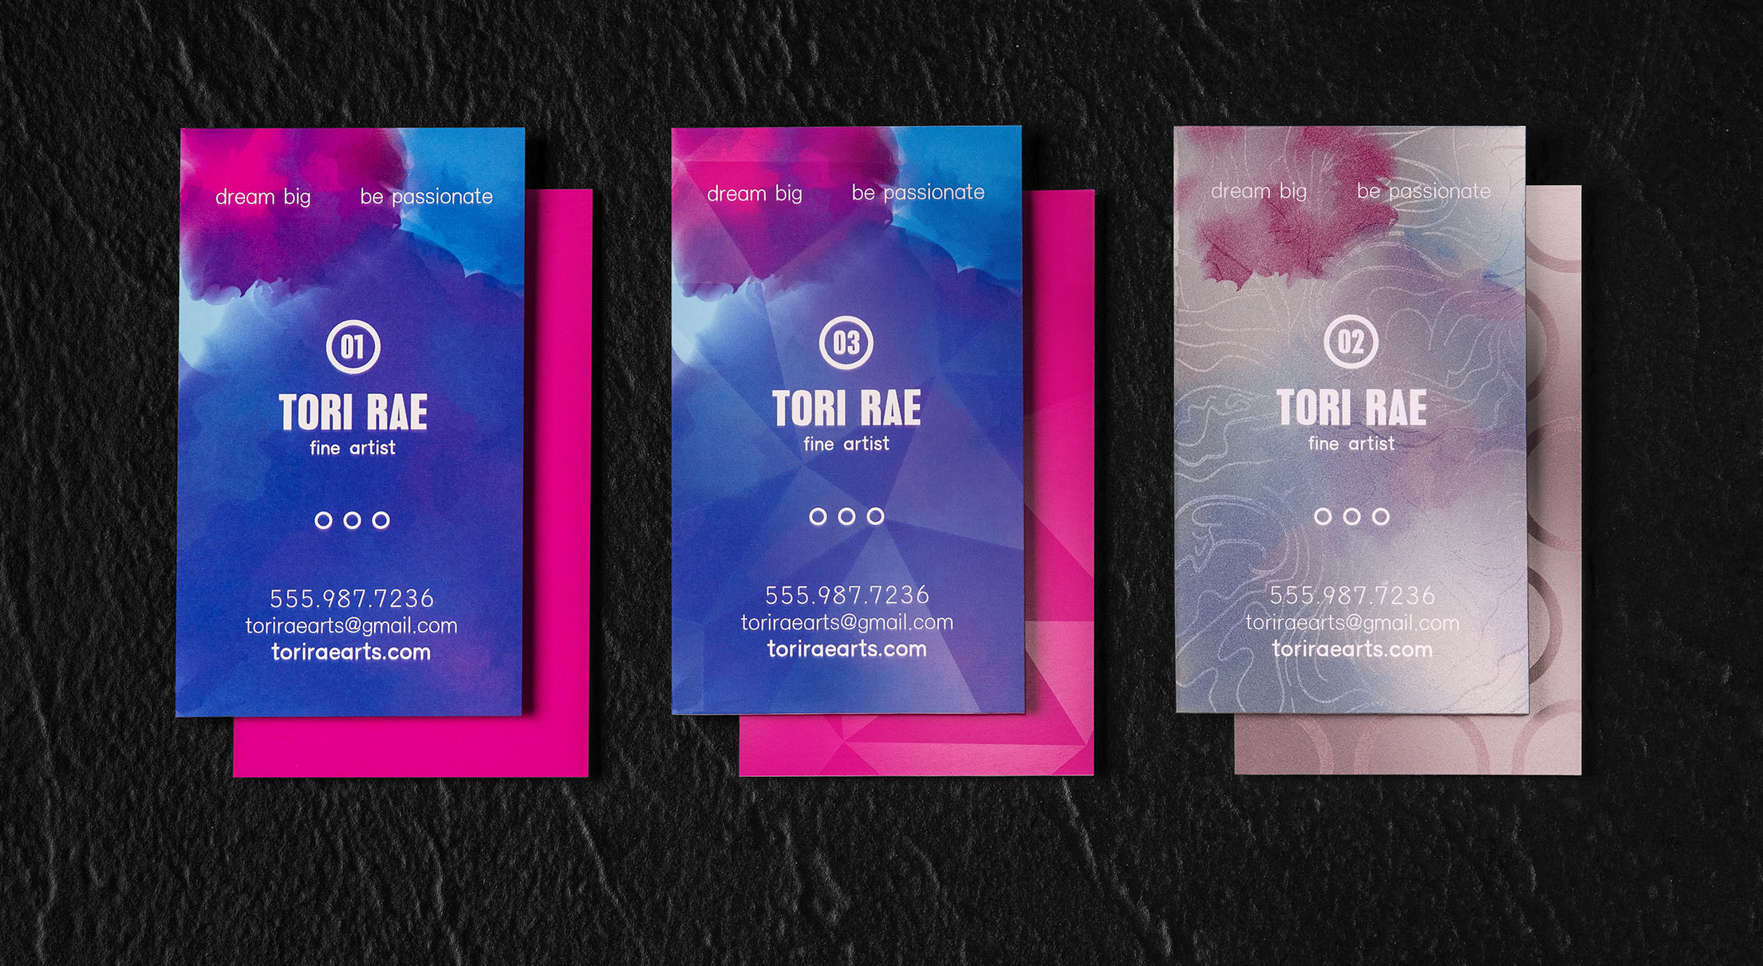
Технология Colour FLX привносит «вау»-эффект
Используя до шести цветных станций печати вы можете получать потрясающие CMYK+ эффекты за быстро и один проход.
ЧЕТЫРЕ ЦВЕТА
ПЯТЬ ЦВЕТОВ
ШЕСТЬ ЦВЕТОВ
Notes:
The secret to the Iridesse “wow” is Colour FLX Technology.
This unique capability gives you two inline specialty dry ink stations, providing the option for specialty underlays and overlays. This ability to mix metallic Silver and Gold with CMYK tints creates brilliant iridescent metallic palettes, and stunning results. Add in Clear spot enhancements in the same, highly productive single pass, and you’re able to boost your value even further.
Colour FLX Technology single-pass printing is a big deal because it’s such a time-saver. On the Xerox Colour 800i/1000i Presses, printing a 6-colour effect requires multiple passes of prints through the press to create special effects with more than one metallic ink. This means that operators need to collect printed stacks and re-load them into input trays and then re-initiate the job a second time. Also, the 800i/1000i Presses enable just one Specialty Dry Ink to be loaded at a time, whereas the Iridesse Press now enables two Specialty Dry Inks to be used inline. These advancements provide for a vast number of application design options and exciting possibilities to expand your product offerings.
Our 6-colour inline architecture also eliminates the registration problems that can arise with multiple passes and dramatically increases the effective speed of the press for metallic jobs. In addition, our HD EA Dry Inks need zero drying time, which is an incredibly productive contrast to what you may be used to with offset inks or offline processes. You can go directly from print to finishing!
A big part of Colour FLX Technology is its EZ Swap capability, which enables fast, efficient Specialty HD EA Dry Ink changeovers so you can vary and execute more high-value print embellishments more easily – with no maintenance or cleanup.

Slide 3
Новые возможности обеспечены технологиями
Автоматическое распрямление листов, упрощённая очистка и точное совмещение обеспечивают непревзойдённую производительность.
Используйте разные материалы в одном задании – до 400 г/м2.
Превосходный готовый продукт
Широкий выбор постпечатного оборудования «в линию» от разных производителей
Точные цвета максимально быстро
Встроенный автоматический FWA- сканер и ACQS
Производительность на смешанных материалах, библиотека материалов, идеальное совмещение
Опции подачи материалов общим объёмом до 12,500 листов из 8 источников.
Notes:
Here’s an overview of some of the top technologies that help you take on these new “wow” opportunities with confidence. We’ll be talking about each of these press technologies in more detail in the next few minutes.
Take the work out of the “wow”—Job submission is flexible and fast with a variety of tools from standard PC and Mac® print drivers to faster and more automated methods like Web submission and custom Hot Folders that reside directly on users’ desktops. Optional Xerox FreeFlow Core workflow software can further accelerate your productivity.
Get to quality colour, fast:
Full Width Array (FWA)—This inline scanning device is unique to Xerox and performs several important functions that maintain quality control for production printing:
Automatic target reads for print server calibration and destination profiling and then sends that data over to colour management software.
The FWA also baselines the press by maintaining uniformity in toner density across the page from the inboard side to the outboard side of the paper, as well as up and down the page from the lead edge to the trail edge.
This tool automatically adjusts the image alignment on the paper (X/Y position, perpendicularity, skew, magnification) and performs an image transfer adjustment that corrects for uneven toner coverage and colour shift—issues that can occur on heavyweight stocks or textured and specialty stocks.
This tool also corrects for mottle (uneven toner coverage) and colour shift, which can occur on heavyweight stocks. Once initiated, the tool automatically creates and saves an adjustment to the Bias Transfer Roll, which is the xerographic component that transfers the image from the belt to the paper. The tool eliminates the need for operators to interpret printed targets and manually enter adjustment values.
Automated Colour Quality Suite (ACQS)—ACQS is advanced colour management software that transfers the complex decisions about colour maintenance from operators to an automated system and eliminates the time and error associated with colour management. Once initiated by an operator, ACQS automates the printing and measuring of calibration charts and then calculates and makes precise adjustments to colour tables based on the results.
Produce complex jobs, even with tight deadlines:
Mixed Media Xceleration (MMX)—MMX includes advanced tray switching and fuser technology with the ability to set mixed media production to Optimise for Speed. When a single job contains different types and weights of media, this setting minimises the loss of speed due to extra paper handling and fusing adjustments. This feature is a competitive differentiator because, on other presses, speeds drop dramatically when printing mixed media.
Stock Library Manager—This versatile tool provides for fast media management in a busy production environment by enabling operators to store a large listing of stock settings and retrieve them with a single click to assign to a press tray.
Give your jobs a brilliant finish—As you would expect from Xerox, the Iridesse Production Press is compatible with a wide range of Xerox- and third-party finishing devices, letting you accelerate production further.

Slide 4
ВЫБОРОЧНЫЙ ЛАК
привлекает внимание и добавляет глубину
ТРИАДНЫЕ ЦВЕТА
создают смешанные металлические цвета
Серебряная подложка основа для создания металлизированных цветов
Создаём радугу эффектов
Название обыгрывает слово “iridescence” (переливчатый) - Iridesse является синонимом визуальных эффектов за пределами CMYK, которые усиливают содержимое страницы и захватывают зрителя - все цвета получаются за один проход
Notes:
I’ve mentioned underlays and overlays a few times since we started talking. Let’s look at how colour layering works with Iridesse using a detail from the postcard job I showed you a few minutes ago.
If you were to take this source file apart, you would see layers built just like this. Silver was applied first in specific areas to create a metallic underlay for CMYK gradients and spot tints on both sides of the postcard.
Multiplying the CMYK layer over the Silver is what gives you the shimmery metallic colours, whether they are spot tints or smoothly blended gradients. You can see from this diagram that our designer specifically chose to make some areas metallic and some straight four colour, which lets the iridescent colours stand out even more.
Finally, an overlay – or top layer – of specific Clear elements puts the finishing touches on the “wow.”
Remember – all this is processed and printed inline at the full rated speed of the press!

Slide 5
Notes:
NOTE TO PRESENTER: This slide includes video with audio. Click to play the video when you’re ready.
As I mentioned a few minutes ago, EZ Swap is a part of Colour FLX Technology, which enables fast, efficient Specialty HD EA Dry Ink changeovers. This lets you take full advantage of a wide array of CMYK+ capabilities.
You can run Silver or Gold in the underlay position, and Silver, Gold, or Clear in the overlay position. Changing a Specialty Dry Ink takes about 15-20 minutes from stopping one job to starting the next – and that includes swapping out the colour housings and the press automatically adjusting the image quality for the new ink.

Slide 6
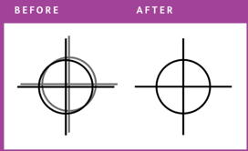
ACQS вместе с FWA (полноразмерный встроенный сканер) дают стабильный и точный цвет и великолепную приводку лицо/оборот.
Цвета должны быть
стабильны в тираже
— одинаковыми
в любой день
= Calibration
Автоматическое выравнивание приводки лицо-оборот по обеим осям
Цвета должны быть
верными —
точное попадание в
цвет
= Profiling
Автоматизированные процессы снижают время и облегчают решение задач управления цветом.
Больше времени на производство и меньше на достижение отличного качества.
Notes:
The Iridesse Production Press has several built-in technologies and tools that help operators easily maintain the best image output that the press can deliver. Some of these tools are fully automatic and others are operator initiated. Together, they maintain optimum image quality for brilliant images and deliver outstanding productivity with maximum up-time and little or no operator intervention for IQ maintenance.
As you may know, the colour settings on any xerographic press naturally drift over time. This occurs because of normal use, changes in temperature and humidity, and paper conditions. When you calibrate the print server and create destination profiles for new stocks, you bring the press back to its original high-quality output and ensure that the output consistently matches industry-standard colours.
ACQS is an advanced colour management technology that transfers the complex decisions about colour maintenance from operators to an automated system. ACQS automates the printing and measuring of calibration charts and then calculates and makes precise adjustments to colour tables based on the results. Operators only need to start the procedure at the print server and then accept the results after the measurements, calculations and corrections are automatically performed. ACQS allows your customers to minimise the time and effort spent on manual tasks, while achieving accurate, consistent results and avoiding errors.
The Full Width Array (FWA) enhances the power of the ACQS colour management software to improve colour stability, accuracy and repeatability. Located right along the paper path, this colour measurement device consists of a series of RGB sensors that spans the entire width of the paper path. As LEDs illuminate test patterns or calibration prints moving along the paper path, a CCD Assembly reads the reflected light from the lamps and measures the red, green and blue light separately. The CCD converts the light into analog voltage signals and sends this data to the unit’s processor for analysis.
Initiated from the EX-P 6 Print Server, ACQS with the Full Width Array semi-automates profiling for accurate colour and calibration for consistent colour. This reduces time and eliminates complex and skilled colour management tasks, meaning more time for production and less time trying to get great quality.

Slide 7
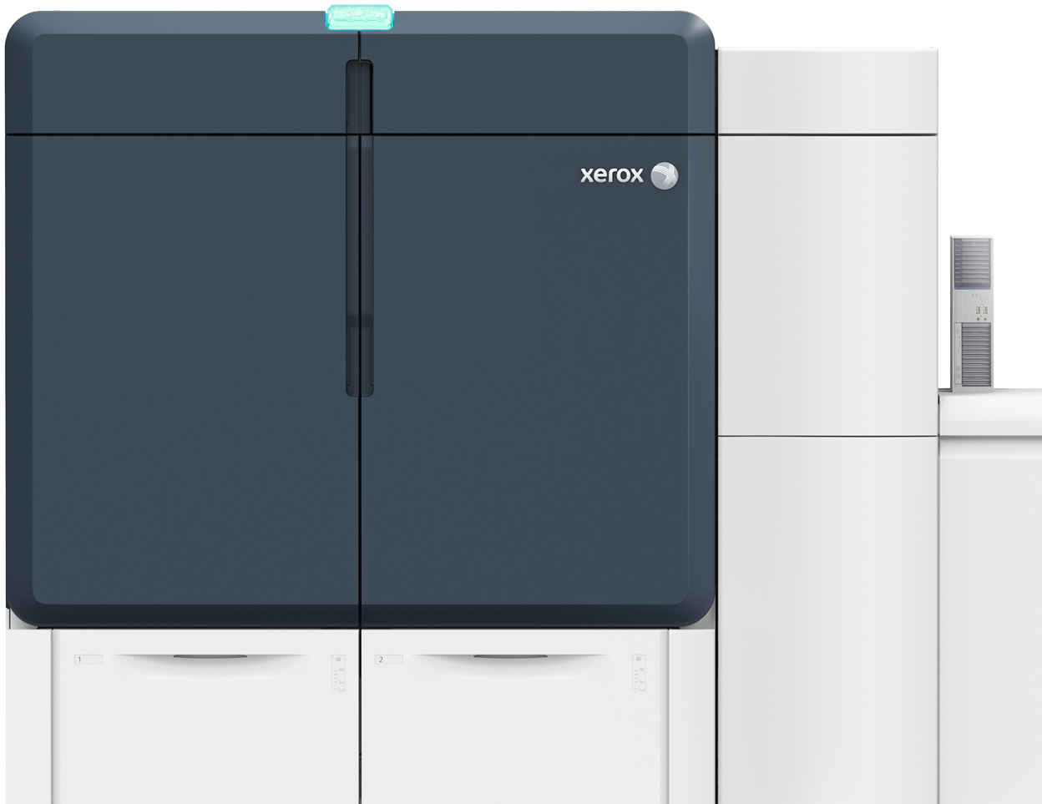
Технические характеристики, обеспечивают блестящий результат
AMPV 225K– 475K
Duty cycle 2.25M
Скорость печати 120 А4/мин (во всём диапазоне материалов)
Материалы для печати 52 – 400 г/м2 (из встроенных лотков)
Размеры бумаги до 330 mm x 1200 mm
Приводка лицо/оборот +/- 0.5mm
RIP разрешение 1200 x 1200 dpi, 10 bits/pixel
Разрешение печати 2400 x 2400 dpi, 1 bit/pixel
Автоматизация качества Full Width Array
Notes:
NOTE TO PRESENTER: Review from screen.

